Slide 1
Weekly report: Electrical Drivetrain
Week number: 10
Date: 02/12/2025
Supervisor: Prof. Dr.-Ing. Saiju
Group members: Aiswarya Vijayan, Vishranti Shivajirao Patil , Girish Mahadeo Padalkar, Cristina Milene Vergara Hernandez

Slide 2
List of contents
Detailed design Electrical parameter of transformer.
Mechanical parameter of transformer.
Mat lab simulation of transformer.
Mat lab simulation Result of transformer.
Cost of All Electrical Drivetrain Components.
Vishranti Patil
Electrical Drive Train/ Optimus Syria

Slide 3
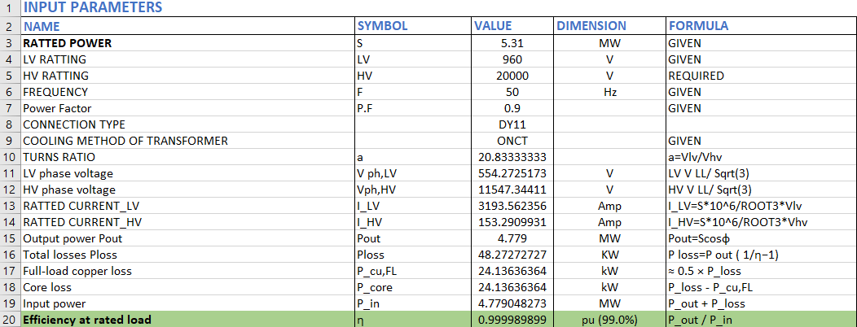
1. Electrical parameter of transformer.
Vishranti Patil

Slide 4
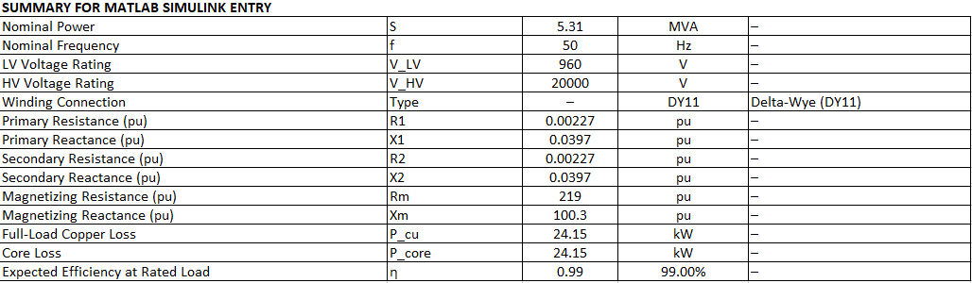
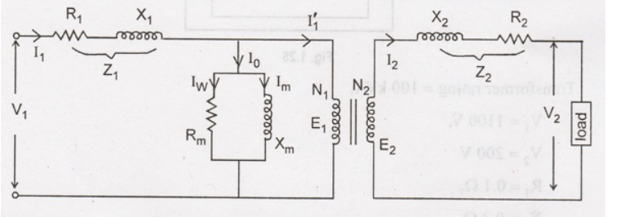

1. Electrical parameter of transformer.
Source: https://ece.poriyaan.in/topic/equivalent-circuit-of-a-transformer-20011/
Vishranti Patil

Slide 5
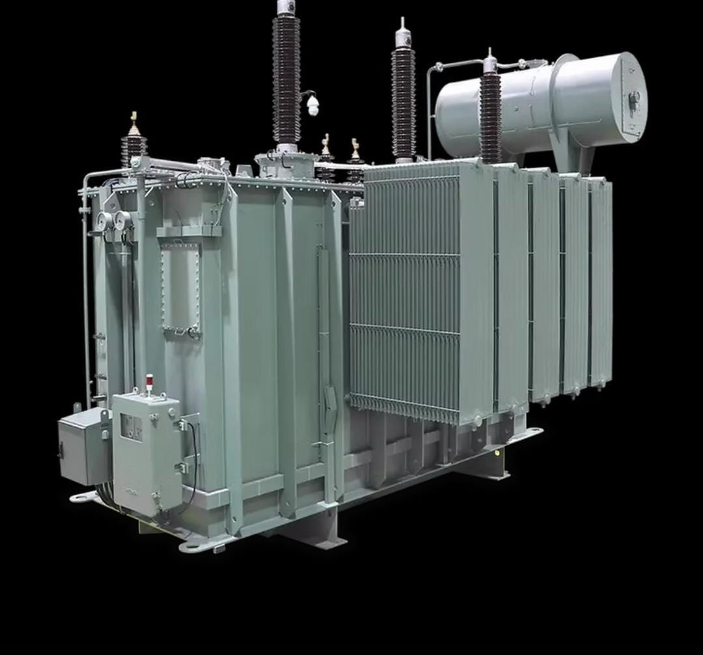
2. Mechanical Dimension of transformer.
Refertence: BETA Elektrotechnik GmbH. “Oil Transformers.” BETA–Elektro, accessed November 29, 2025. https://www.beta-elektro.com/oil-transformers
PHYSICAL PARAMETER | LENGTH | HEIGHT | WIDTH
TRANSFORMER DAIMENSION | 2.7M | 2.1M | 2.4M
Vishranti Patil

Slide 6
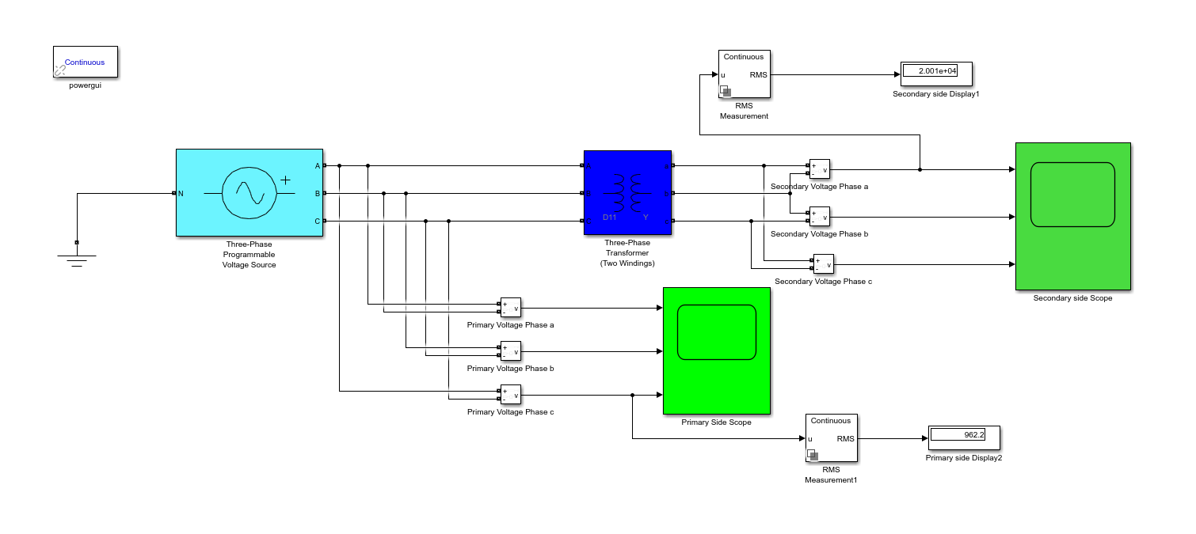
3. Mat lab simulation of transformer.
Transformer scheme . Source [own]. 28.11.2025
Vishranti Patil

Slide 7
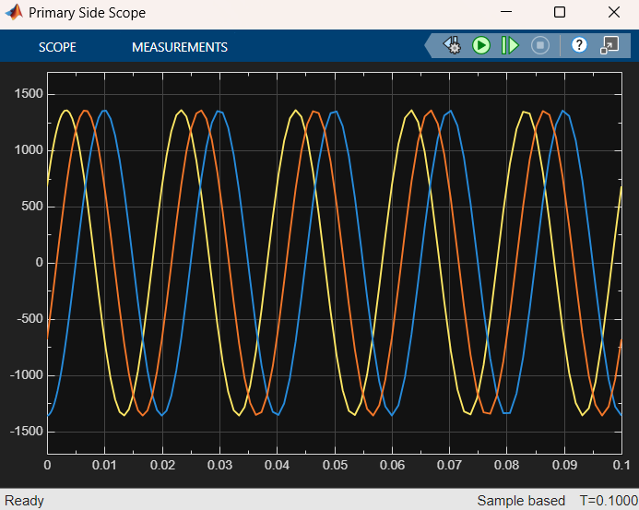
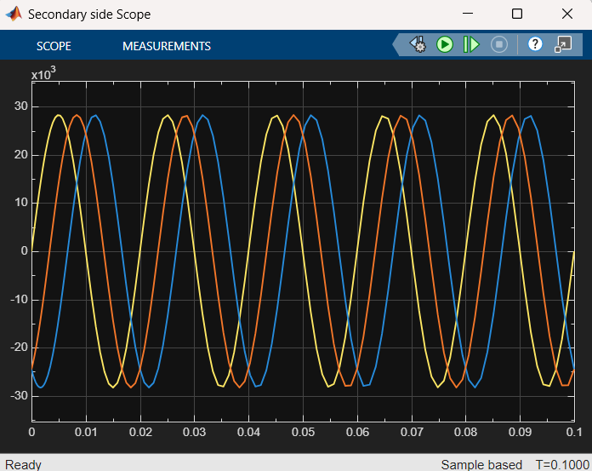
4. Mat lab simulation Result of transformer.
Primary Voltages Secondary Voltages
Transformer scheme . Source [own]. 28.11.2025
Vishranti Patil

Slide 8
5. Cost of All Electrical Drivetrain Components.
Components | Prizes Range
1. Generator | 300,000–600,000 EUR
2. Converter | 80,000-150,000 EUR
3. Transformer | 37,000–74,000 EUR
4. Cables & Switch Gears | 30,000-100,000 EUR
Vishranti Patil

Slide 9
6.Next Step
To finalize the simulation for all components combined.
To finalize the CAD model of the electrical drive train;
To start the redaction of report and final presentation.
Using power factory results to make final selection of cables and switchgear.
Vishranti Patil

Slide 10

Bibliography
1. Source [1]: Electrical machines and power electronics course Prof.Dr.-Ing Rajesh Saiju,
2. Source [2]: Power system analysis by hadi saadat. [ 25.11.2025]
3. BETA Elektrotechnik GmbH. “Oil Transformers.” BETA–Elektro, accessed November 29, 2025. https://www.beta-elektro.com/oil-transformers
4. Equivalent Circuit of a Transformer,” Poriyaan. [Online]. Available: https://ece.poriyaan.in/topic/equivalent-circuit-of-a-transformer-20011/. [Accessed: Nov. 29, 2025].
5. Source [3]: Electrical engineering for wind turbines course of Prof. Dr. Ingmar Leise. [ 02.12.2025]
02/12/2025

